Slide 1



Wood CAF Sub
View in Power BI
Last data refresh:
3/12/2024 4:12:51 PM UTC
Downloaded at:
3/12/2024 6:34:25 PM UTC

Slide 2
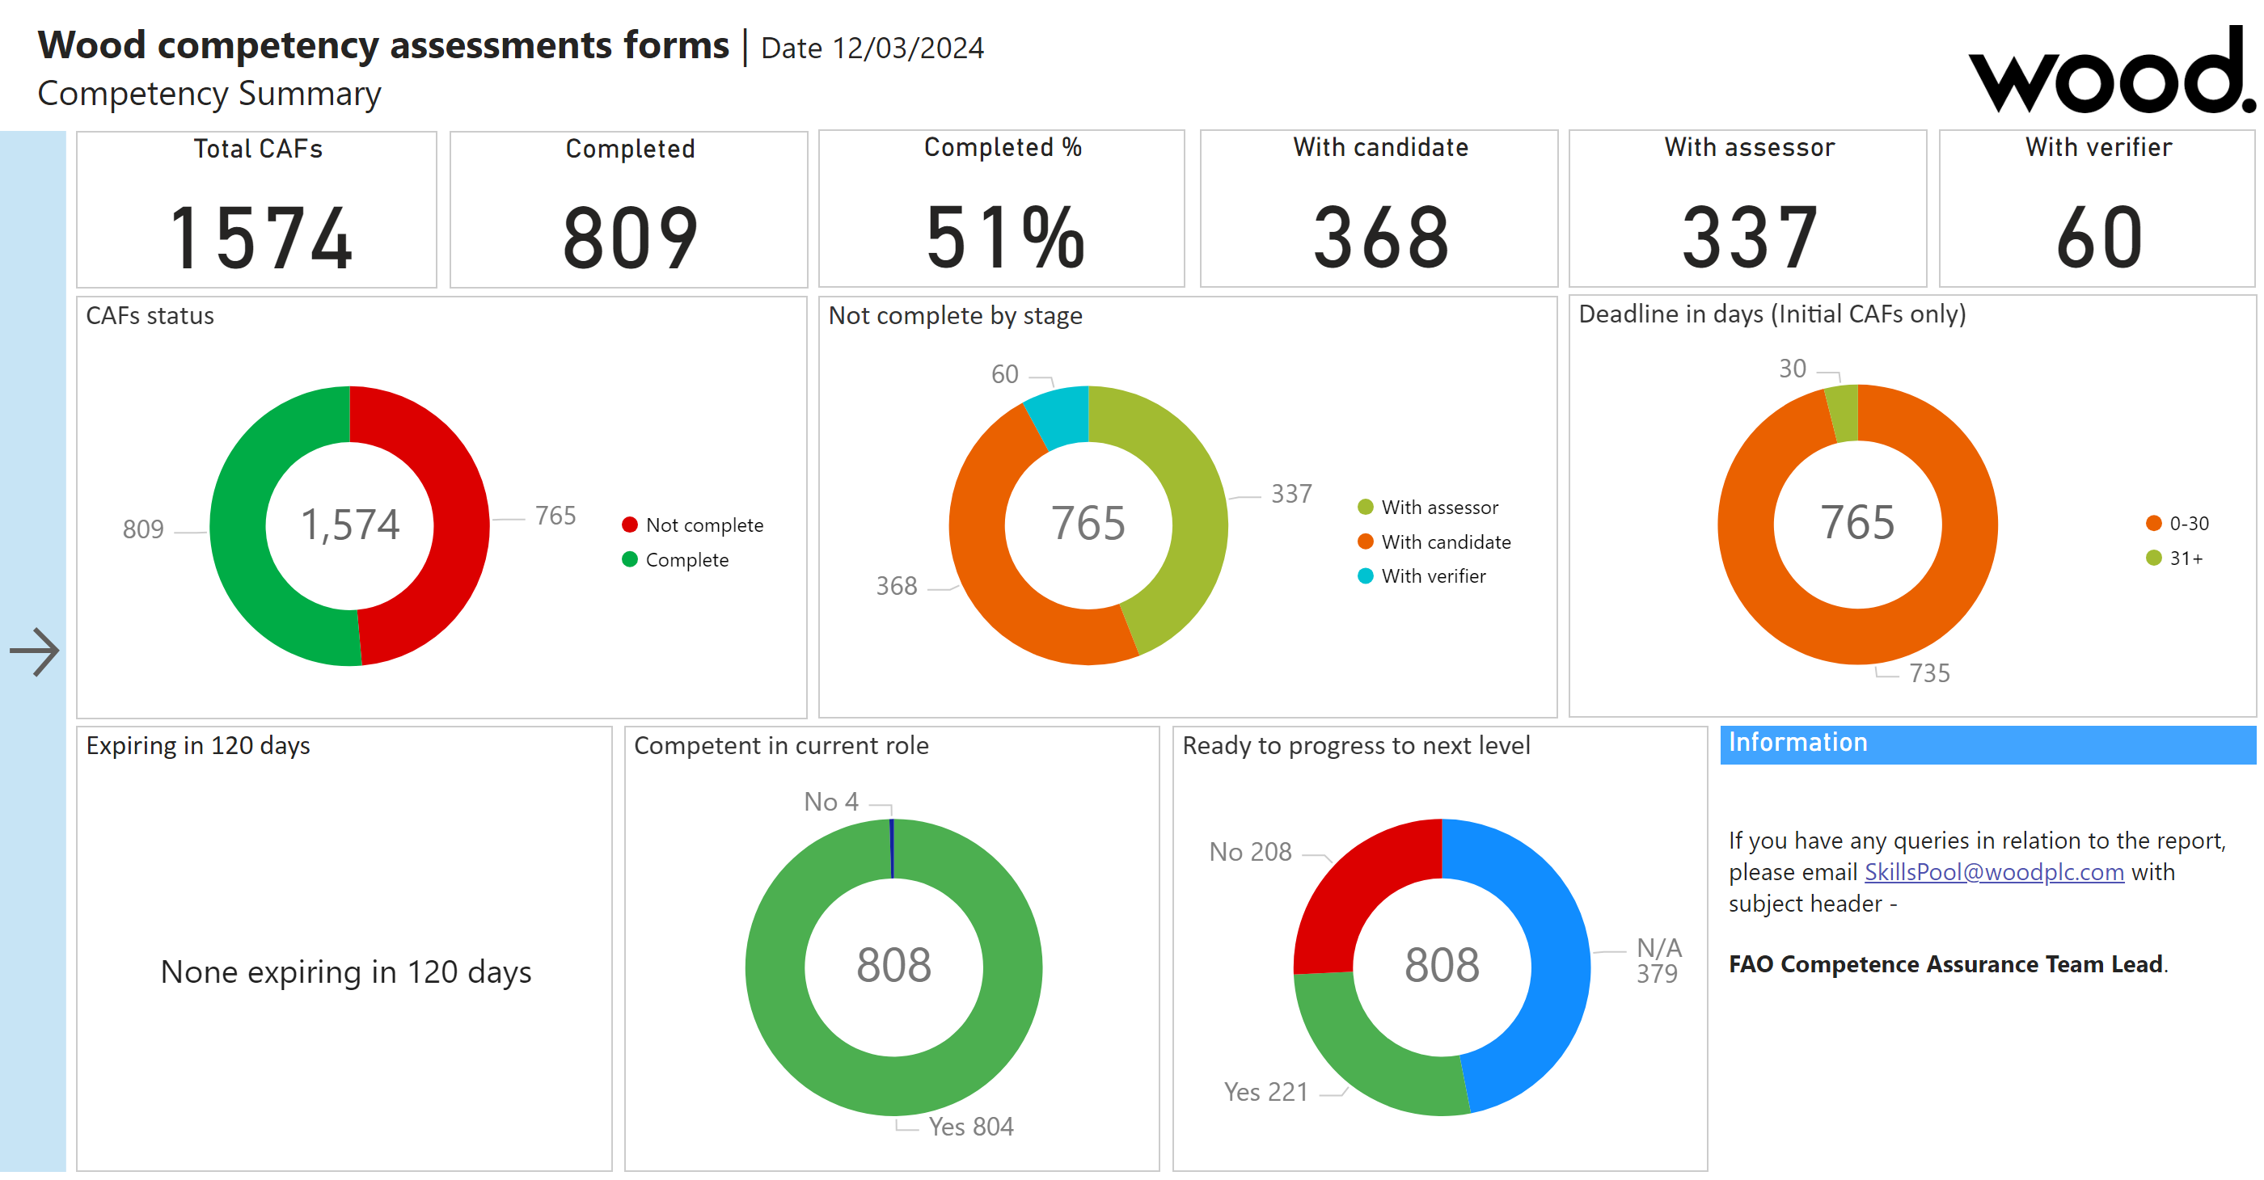
Summary
Notes:
slicer
No alt text provided
Ready to progress to next level
No alt text provided
actionButton
No alt text provided
slicer
No alt text provided
slicer
No alt text provided
slicer
No alt text provided
slicer
No alt text provided
Expiring in 120 days
No alt text provided
Information
No alt text provided
actionButton
No alt text provided
Showslicer
No alt text provided
textbox
No alt text provided
slicer
No alt text provided
actionButton
No alt text provided
slicer
No alt text provided
slicer
No alt text provided
Competent in current role
No alt text provided
CAFs status
No alt text provided
With verifier
No alt text provided
With candidate
No alt text provided
With assessor
No alt text provided
Completed %
No alt text provided
Deadline in days (Initial CAFs only)
No alt text provided
image
No alt text provided
textbox
No alt text provided
Not complete by stage
No alt text provided
Completed
No alt text provided
Total CAFs
No alt text provided

